Slide 1
Introduction to PDV, formats and Informats, controlling input and output data
SAS® Training
Release Date: DD-Mmm-YYYY

Slide 2
Data Set Processing
Data Set Processing
DATA steps read in data from existing data sets or raw data files one row at a time, like a loop
DATA step reads data from the input data set in the following way:
1. Read in current row from input data set to Program Data Vector (PDV)
2. Process SAS statements
3. PDV to output data set
4. Set current row to the next row in the input data set
5. Iterate to Step 1
One row at a time is processed
Thus we cannot simply add the value of a variable in one row to the value in another row
Notes:
2
2

Slide 3
Data Set Processing
Data Set Processing – Example
Let the following be the input data set dfwlax:
Flight | Date | Dest | FirstClass | Economy
439 | 14955 | LAX | 20 | 137
921 | 14955 | DFW | 15 | 131
114 | 14956 | LAX | 15 | 85
982 | 14956 | DFW | 5 | 196
439 | 14957 | LAX | 14 | 116
982 | 14957 | DFW | 20 | 166
Notes:
3
3

Slide 4
Data Set Processing
Data Set Processing – Example
Consider the following submitted code:
DATA onboard;
SET dfwlax;
Total=FirstClass+Economy;
IF FirstClass=20 then FirstClassFull=1;
ELSE FirstClassFull=0;
RUN;
Notes:
4
4

Slide 5
Data Set Processing
Data Set Processing – Example
Execution of the Data Step
DATA onboard;
Current → SET dfwlax;
Total=FirstClass+Economy;
IF FirstClass=20 then FirstClassFull=1;
ELSE FirstClassFull=0;
RUN;
PDV
Onboard
Flight | Date | Dest | FirstClass | Economy | Total | FirstClassFull
439 | 14955 | LAX | 20 | 137 | . | .
Flight | Date | Dest | FirstClass | Economy | Total | FirstClassFull
Notes:
5
5

Slide 6
Data Set Processing
Data Set Processing – Example
Execution of the Data Step
DATA onboard;
SET dfwlax;
Current → Total=FirstClass+Economy;
IF FirstClass=20 then FirstClassFull=1;
ELSE FirstClassFull=0;
RUN;
PDV
Onboard
Flight | Date | Dest | FirstClass | Economy | Total | FirstClassFull
439 | 14955 | LAX | 20 | 137 | 157 | .
Flight | Date | Dest | FirstClass | Economy | Total | FirstClassFull
Notes:
6
6

Slide 7
Data Set Processing
Data Set Processing – Example
Execution of the Data Step
DATA onboard;
SET dfwlax;
Total=FirstClass+Economy;
Current→ IF FirstClass=20 then FirstClassFull=1;
ELSE FirstClassFull=0;
RUN;
PDV
Onboard
Flight | Date | Dest | FirstClass | Economy | Total | FirstClassFull
439 | 14955 | LAX | 20 | 137 | 157 | 1
Flight | Date | Dest | FirstClass | Economy | Total | FirstClassFull
Notes:
7
7

Slide 8
Data Set Processing
Data Set Processing – Example
Execution of the Data Step
DATA onboard;
SET dfwlax;
Total=FirstClass+Economy;
IF FirstClass=20 then FirstClassFull=1;
ELSE FirstClassFull=0;
Current→ RUN;
PDV
Onboard
Flight | Date | Dest | FirstClass | Economy | Total | FirstClassFull
439 | 14955 | LAX | 20 | 137 | 157 | 1
Flight | Date | Dest | FirstClass | Economy | Total | FirstClassFull
439 | 14955 | LAX | 20 | 137 | 157 | 1
Notes:
8
8

Slide 9
Data Set Processing
Data Set Processing – Example
Execution of the Data Step
Current→ DATA onboard;
SET dfwlax;
Total=FirstClass+Economy;
IF FirstClass=20 then FirstClassFull=1;
ELSE FirstClassFull=0;
RUN;
PDV
Onboard
Flight | Date | Dest | FirstClass | Economy | Total | FirstClassFull
439 | 14955 | LAX | 20 | 137 | . | .
Flight | Date | Dest | FirstClass | Economy | Total | FirstClassFull
439 | 14955 | LAX | 20 | 137 | 157 | 1
Notes:
9
9

Slide 10
Data Set Processing
Data Set Processing – Example
Execution of the Data Step
DATA onboard;
Current→ SET dfwlax;
Total=FirstClass+Economy;
IF FirstClass=20 then FirstClassFull=1;
ELSE FirstClassFull=0;
RUN;
PDV
Onboard
Flight | Date | Dest | FirstClass | Economy | Total | FirstClassFull
921 | 14955 | DFW | 15 | 131 | . | .
Flight | Date | Dest | FirstClass | Economy | Total | FirstClassFull
439 | 14955 | LAX | 20 | 137 | 157 | 1
Notes:
10
10

Slide 11
Data Set Processing
Data Set Processing – Example
Execution of the Data Step
DATA onboard;
SET dfwlax;
Current→ Total=FirstClass+Economy;
IF FirstClass=20 then FirstClassFull=1;
ELSE FirstClassFull=0;
RUN;
PDV
Onboard
Flight | Date | Dest | FirstClass | Economy | Total | FirstClassFull
921 | 14955 | DFW | 15 | 131 | 146 | .
Flight | Date | Dest | FirstClass | Economy | Total | FirstClassFull
439 | 14955 | LAX | 20 | 137 | 157 | 1
Notes:
11
11

Slide 12
Data Set Processing
Data Set Processing – Example
Execution of the Data Step
DATA onboard;
SET dfwlax;
Total=FirstClass+Economy;
IF FirstClass=20 then FirstClassFull=1;
Current→ ELSE FirstClassFull=0;
RUN;
PDV
Onboard
Flight | Date | Dest | FirstClass | Economy | Total | FirstClassFull
921 | 14955 | DFW | 15 | 131 | 146 | 0
Flight | Date | Dest | FirstClass | Economy | Total | FirstClassFull
439 | 14955 | LAX | 20 | 137 | 157 | 1
Notes:
12
12

Slide 13
Data Set Processing
Data Set Processing – Example
Execution of the Data Step
DATA onboard;
SET dfwlax;
Total=FirstClass+Economy;
IF FirstClass=20 then FirstClassFull=1;
ELSE FirstClassFull=0;
Current→ RUN;
PDV
Onboard
Flight | Date | Dest | FirstClass | Economy | Total | FirstClassFull
921 | 14955 | DFW | 15 | 131 | 146 | 0
Flight | Date | Dest | FirstClass | Economy | Total | FirstClassFull
439 | 14955 | LAX | 20 | 137 | 157 | 1
921 | 14955 | DFW | 15 | 131 | 146 | 0
Notes:
13
13

Slide 15
SAS Formats

Slide 16
What are formats?
Formats define the appearance of data values
Formats do not change the internal value of the data
Can be used to improve appearance
Can also be used to group data

Slide 17
What are formats?
Can use either SAS supplied formats or create your own using PROC Format
Formats can be applied in both DATA and PROC steps
Formats applied in DATA steps (or PROC Datasets) are permanent
Formats applied in PROC steps only apply within the procedure

Slide 18
Examples of formats
Pre-formatted value | Format | Formatted value
2125854 | comma10. | 2,125,854
52115 | dollar24.2 | $52,115.00
17526 | mmddyy8. | 12/26/07
17526 | weekdate. | Wednesday, December 26, 2007
M | $Gender. | Male
12 | AgeGroup. | Under 18
C | $PassFail. | Passing Grade

Slide 19
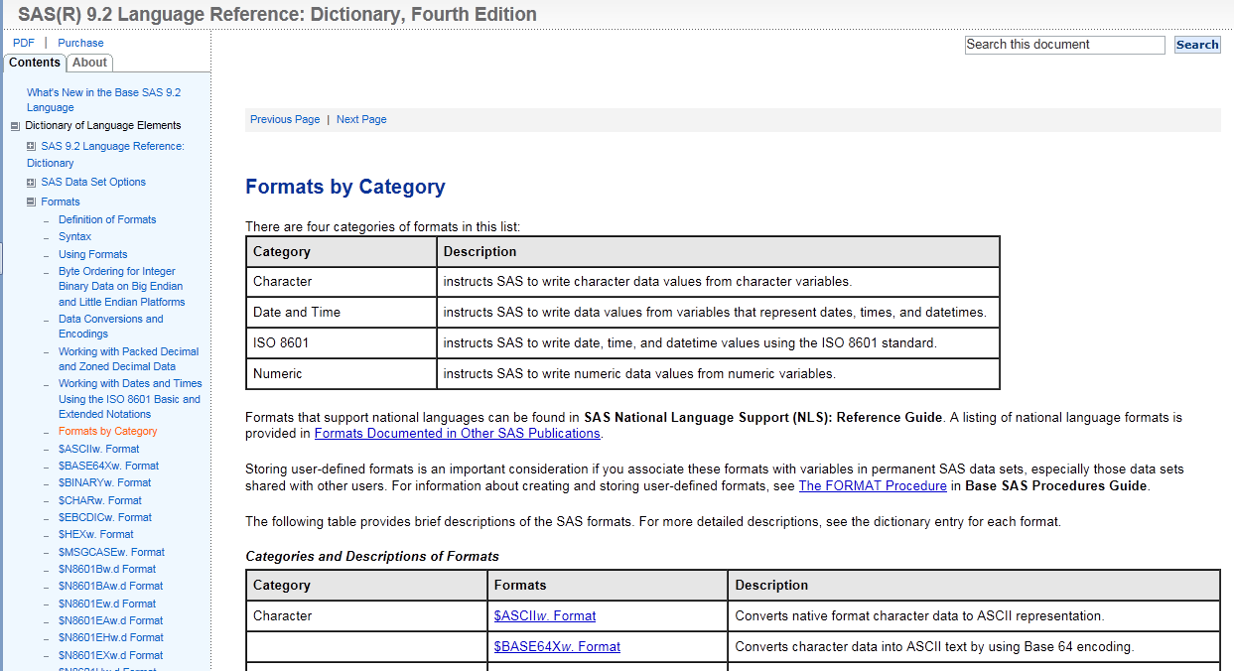
Examples of formats
SAS Documentation

Slide 20
Format names
<$>format<w>.<d>
$ : indicates a character format; absence indicates numeric format
format : names the format
w : format width (number of columns)
d : optional decimal scaling factor (number of columns after decimal point)

Slide 21
Format names
dollar14.2
Numeric format (input values are numeric)
Format named “dollar”
Output value will be 14 columns wide (max)
2 columns are for the decimal part of the value.
This leaves 12 columns for all other characters, including the decimal point, dollar sign, commas, minus sign, etc.
Max value represented: $99,999,999.99

Slide 22
Reading External Data

Slide 23
What are informats?
Informats are instructions that tell SAS how to read a data value
Can be as simple as w.d
3.1 tells SAS to read ‘123’ as 12.3
$3. tells SAS to read ‘123’ as ‘123’ and store it as character data
Excellent for reading dates, dollars, and percents
MMDDYY8. tells SAS to read ’12/26/07’ and store it as 17526 (a SAS date that can be used for calculations, etc.)

Slide 24
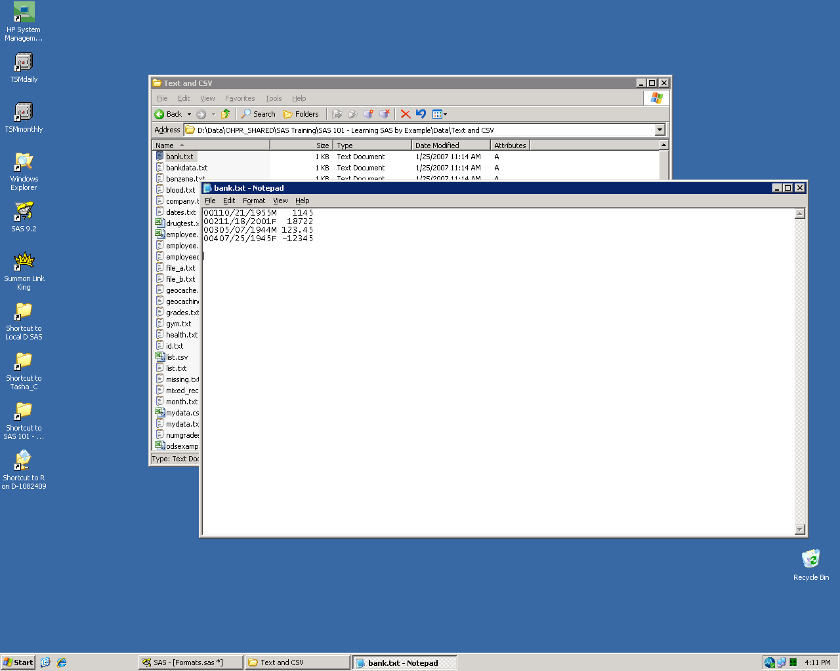
Reading data from a text file
Four variables: Subj, DOB, Gender, Balance
Fixed column data

Slide 25
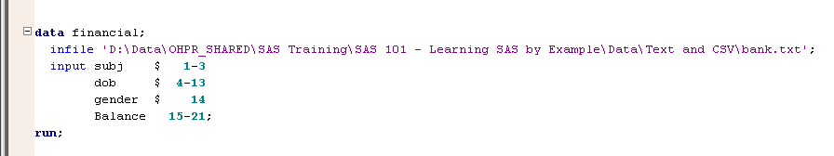
Reading data from a text file
subj – name of variable
$ – indicates character variable
1-3 – indicates starting and ending columns

Slide 26
Reading data from a text file
Date of birth would be stored as a character variable.
Wouldn’t be able to perform calculations or change format of data.
subj – name of variable
$ – indicates character variable
1-3 – indicates starting and ending columns

Slide 27
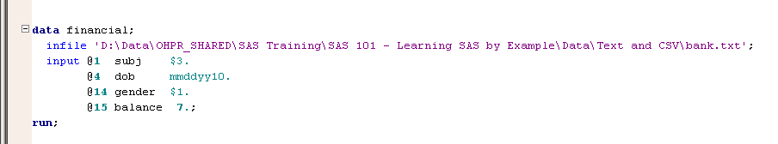
Reading data from a text file
@1 – indicates starting column
subj – name of variable
$3. – indicates informat (how to read the input data values)

Slide 28
Reading data from a text file
Date of birth would be stored as a numeric SAS date.
Can now perform calculations or change format of data.
@1 – indicates starting column
subj – name of variable
$3. – indicates informat (how to read the input data values)

Slide 29
Reading external data
There are numerous ways to read raw data into SAS
My favorite… PROC Import (with a twist)

Slide 30
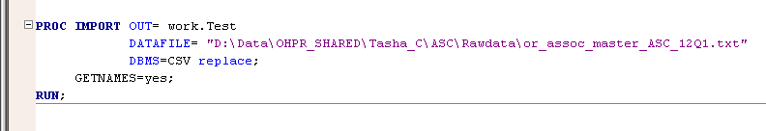
PROC Import
PROC Import reads raw data to a SAS dataset
Easy to use, but…
Clunky and hard to customize
Uses first twenty lines of input file to decide which informat to use
Can often result in truncated variables and values that are not formatted correctly

Slide 31
PROC Import
OUT= name of output SAS dataset
DATAFILE= where to find the data (same as INFILE)
DBMS= type of incoming raw data (in this case comma-separated)
REPLACE option that allows existing SAS data set to be overwritten (useful if you run the same procedure more than once)
GETNAMES=yes uses the first record of input file to generate variable names

Slide 32
PROC Import (with a twist)
Run PROC Import
Copy the SAS log to the Program Editor
PROC Import will create a DATA step with INFILE and INPUT statements in the log
Delete any non-SAS code
Modify informats, formats, and lengths (as needed)
Run the new code

Slide 33
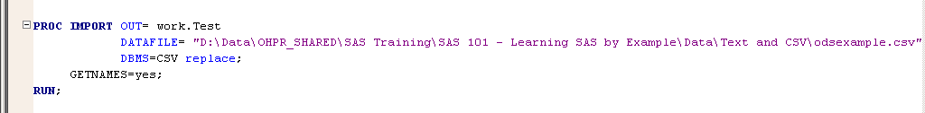
PROC Import (with a twist)
Run PROC Import
Copy the SAS log to the Program Editor
Delete any non-SAS code
Modify informats, formats, and lengths (as needed)
Run the new code

Slide 34
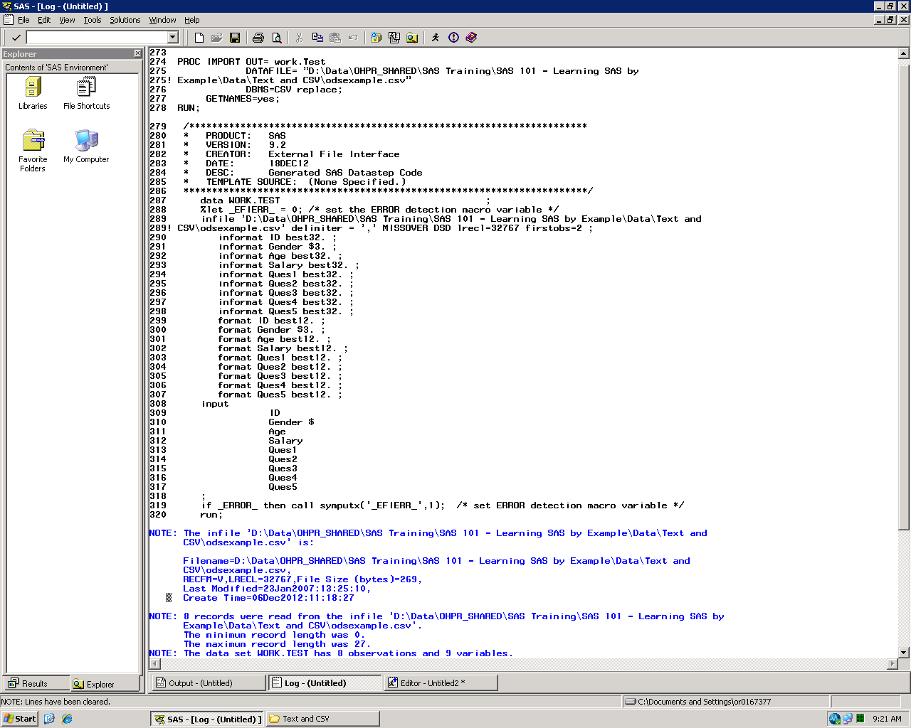
PROC Import (with a twist)
Run PROC Import
Copy the SAS log to the Program Editor
Delete any non-SAS code
Modify informats, formats, and lengths (as needed)
Run the new code

Slide 35
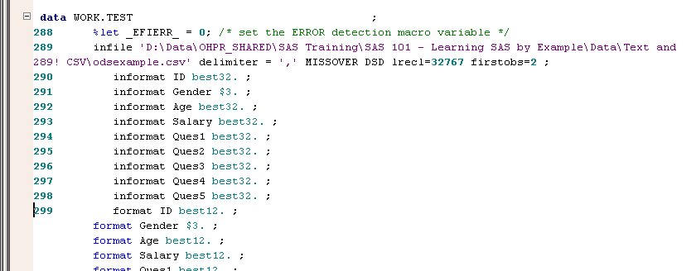
PROC Import (with a twist)
Run PROC Import
Copy the SAS log to the Program Editor
Delete any non-SAS code
Modify informats, formats, and lengths (as needed)
Run the new code

Slide 36
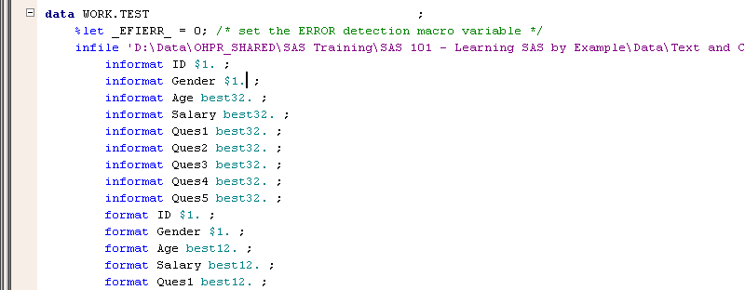
PROC Import (with a twist)
Changed ID to character
Changed length of Gender to 1
Run PROC Import
Copy the SAS log to the Program Editor
Delete any non-SAS code
Modify informats, formats, and lengths (as needed)
Run the new code

Slide 37
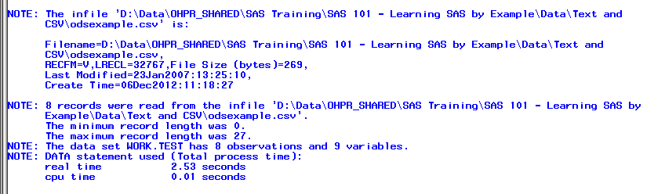
PROC Import (with a twist)
Run PROC Import
Copy the SAS log to the Program Editor
Delete any non-SAS code
Modify informats, formats, and lengths (as needed)
Run the new code

Slide 39
PROC Format
How to Create your own formats

Slide 40
PROC Format
PROC Format allows you to create your own formats
Can create formats for numeric or character data

Slide 41
PROC Format
User-created format names cannot end with a number
(Trailing numbers used to specify width – w.d)
Formats created with value statement used to convert appearance of data values to specified character string
Formats created with picture statement used to create a template for printing numbers
For example – 5033755698 becomes (503)375-5698

Slide 42
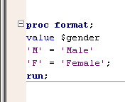
PROC Format
value $gender
Value statement begins new format
Can create more than one format per PROC Format
$gender is the name of the new format
Format name begins with a $ to indicate that the format is to be applied to Character data
Input value
Output value

Slide 43
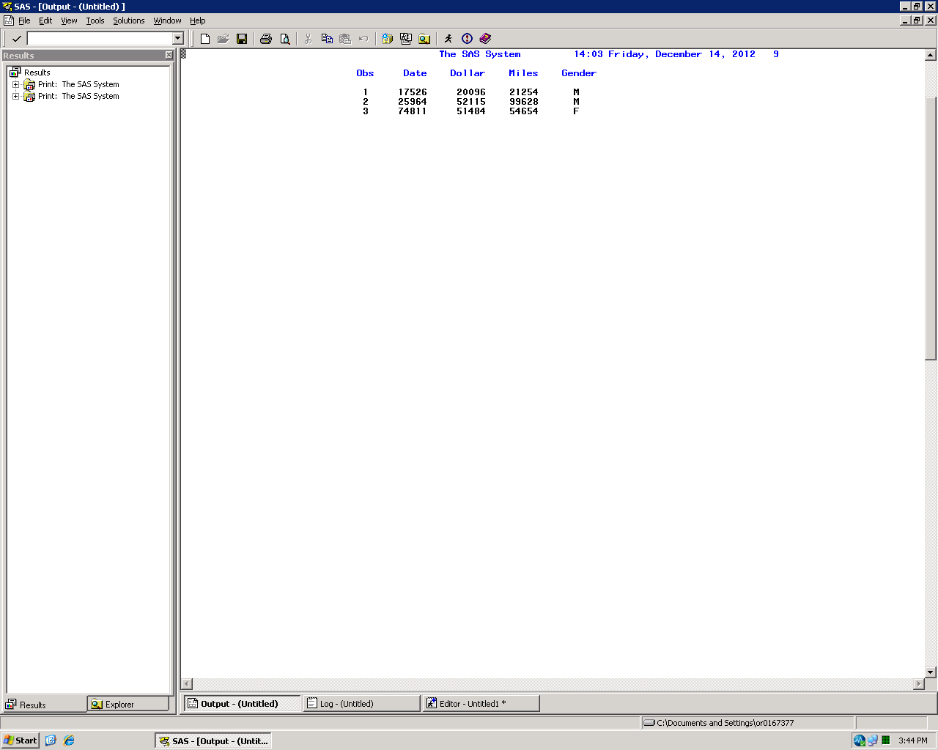
PROC Format
Unformatted output

Slide 44
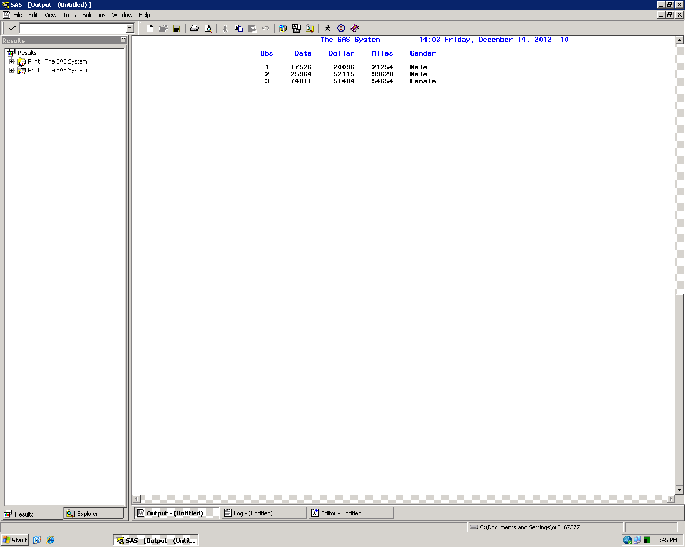
PROC Format
Output with $Gender format applied to gender variable

Slide 45
PROC Format
value $gender
Data values that do not match the specified list of input values appear in their unformatted form
Data value of ‘U’ would appear as ‘U’ in the output
Input values are case sensitive
Data value of ‘m’ wouldn’t match to 'M' = 'Male'

Slide 46
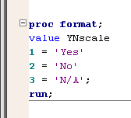
PROC Format
value YNscale
Value statement begins new format
YNscale is the name of the new format
Format name does not begins with a $ to indicate that the format is to be applied to Numeric data

Slide 47
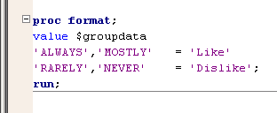
PROC Format
value $groupdata
Can use formats to group data
Groups must be mutually exclusive
Unless using multilabel formats
Can group either character and numeric data

Slide 48
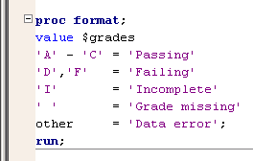
PROC Format
value $grades
Can use lists or ranges in the input values
Can create a formatted value for missing data
Blanks for character ' ' = 'Missing'
Periods for numeric . = 'Missing'
Can use other or else option to capture non-specified input values

Slide 49
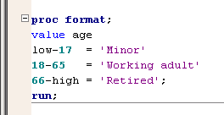
PROC Format
value age
Can use low or high to capture outer bounds of input values
Caution! Make sure you have clean data!
What if the input dataset used 255 as their value for missing age?

Slide 50
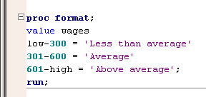
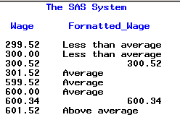
PROC Format
value wages
Watch out for the cracks!
Oops!
Whoops!

Slide 51
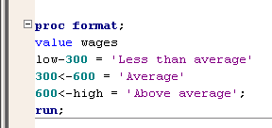
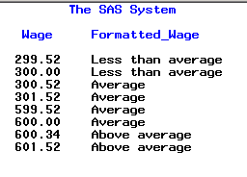
PROC Format
value wages
Solution: Use < symbol
Up to, but excluding, listed value
Can be used on either side of the dash
“600<-high”
means “600.000000..01 through upper limit”

Slide 52
Using Formats

Slide 53
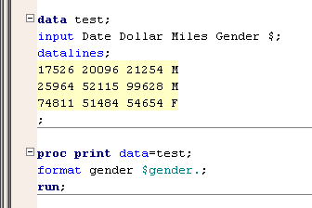
Using formats
Use a format statement to apply formats in PROC steps

Slide 54
Using formats
Output with $Gender format applied to gender variable

Slide 55
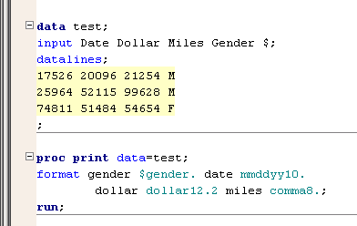
Using formats
Can apply more than one format in a single format statement

Slide 56
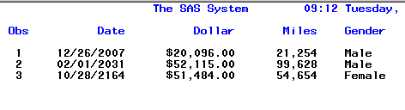
Using formats
Output with formats applied to every variable

Slide 57
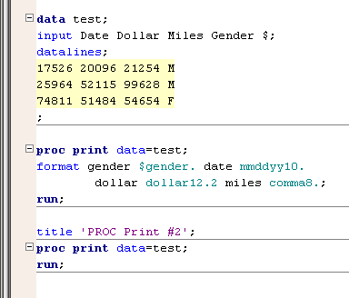
Using formats
Formats applied in a PROC step only apply to that PROC step

Slide 58
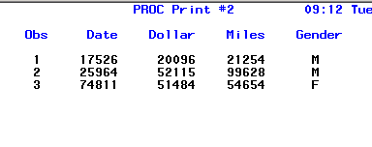
Using formats
Second PROC Print step with no formats applied

Slide 59
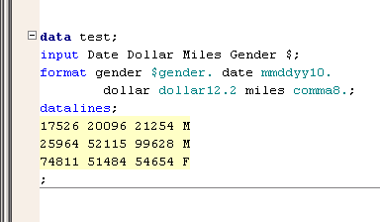
Using formats
Formats can also be applied in a DATA step
Unlike a PROC step, format statements in a DATA step will permanently associate the format with the variable

Slide 60
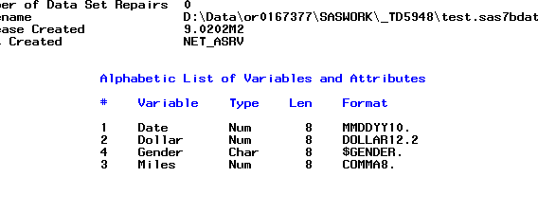
Using formats
PROC Contents of work.test
Formats become part of the attributes of the dataset

Slide 61
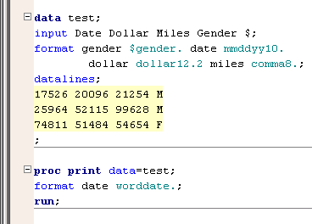
Using formats
Even if formats have been applied in a DATA step, they can be temporarily superseded by a PROC step
(or permanently overwritten with another DATA step)

Slide 62
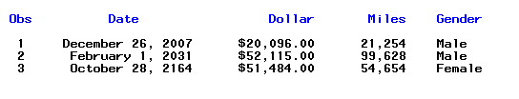
Using formats
PROC Print with worddate. format applied to Date variable

Slide 63
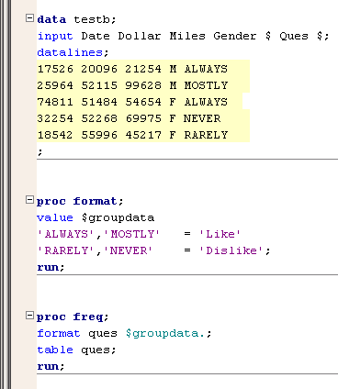
Using formats
Formats can be used to group data in analytical and reporting procedures
(such as PROC Means, PROC Freq, etc.)

Slide 64
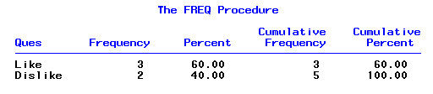
Using formats
Analyses will be performed on the formatted values

Slide 65
Using Labels

Slide 66
Using labels
Like formats, labels can be applied to variables in either the DATA or PROC step
Labels applied in DATA steps (or PROC Datasets) are permanent
Labels applied in PROC steps only apply within the procedure
Labels are created using the label statement
Some procedures require additional options to specify use of labels (vs. variable names) in output

Slide 67
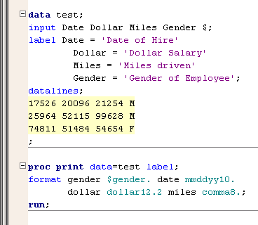
Using labels
The label statement can be used in either a DATA or PROC step
PROC Print requires a label option when you want to display labels (instead of field names) in the column header

Slide 68
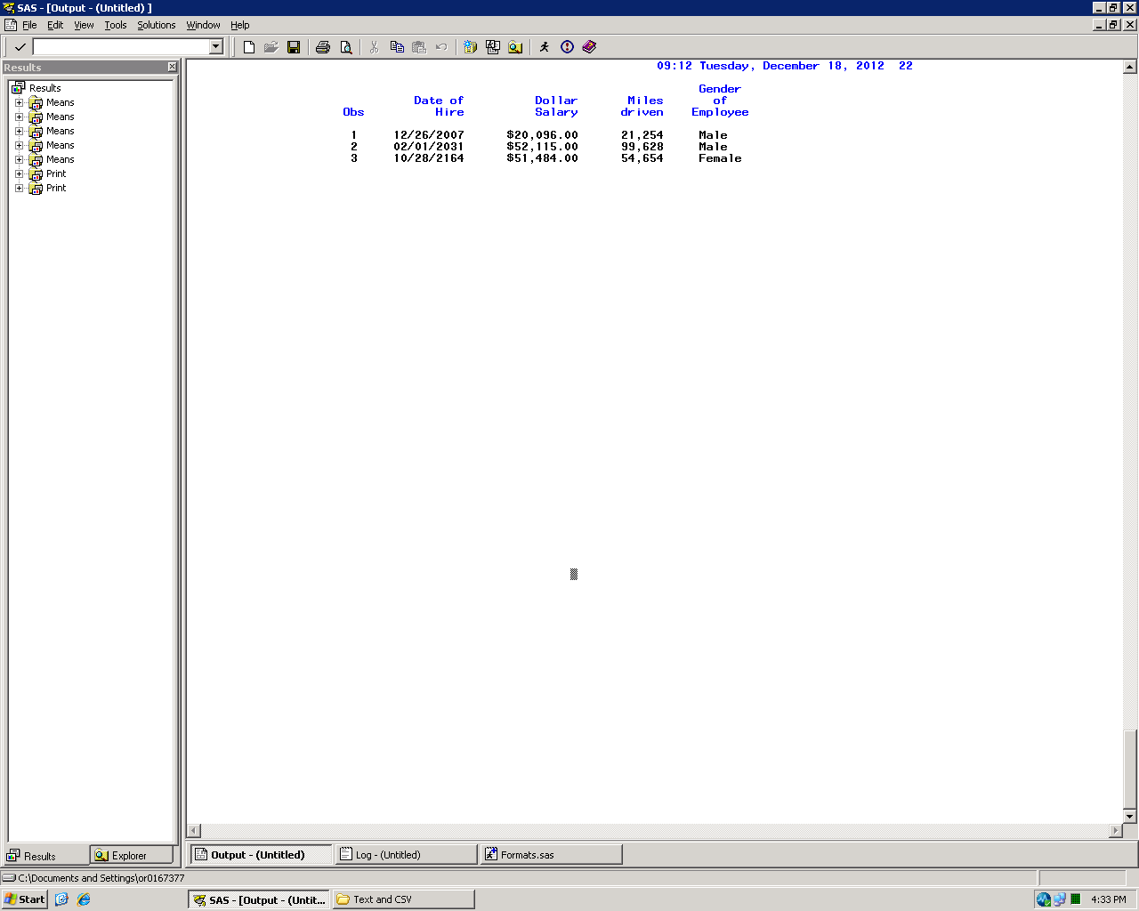
Using labels
Example of a label statement

Slide 69
PROC Dataset

Slide 70
PROC Datasets
PROC Datasets allows you to change the permanent attributes of a dataset without running a DATA step
Labels
Formats
Rename variables
and more…
Less processing time
Don’t need to recreate a dataset
Remember every DATA step creates a new dataset!

Slide 71
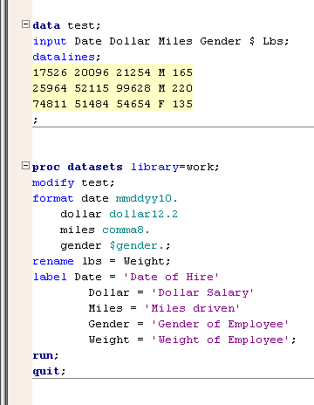
PROC Datasets
PROC Datasets
library= Specify the library where the datasets reside
modify Specify the dataset you want to modify
Can make more than one modification per dataset
Can modify more than one dataset per PROC Datasets
Put a run between each modify statement
End procedure with a quit statement

Slide 73
SAS Informats
SAS informats have the following form:
<$>informat<w>.<d>
$ | indicates a character informat.
informat | names the SAS informat or user-defined informat.
w | specifies the number of columns to read in the input data.
. | is a required delimiter.
d | specifies an optional decimal scaling factor in the numeric informats.
Notes:
Informats are similar to formats which we talked about starting in Chapter 5. Formats are how we want the data to look going out. Informats are how the data looks so we can read it in. We are going to see that the width is not going to be important so much in our informats because we have a delimited file. We still want to read from delimiter to delimiter and the informat will give SAS the general idea of the layout.

Slide 74
SAS Informats
Selected SAS Informats:
Informat | Definition
$w. | reads standard character data.
w.d | reads standard numeric data.
COMMAw.d DOLLARw.d | reads nonstandard numeric data and removes embedded commas, blanks, dollar signs, percent signs, and dashes.
COMMAXw.d DOLLARXw.d | reads nonstandard numeric data and removes embedded periods, blanks, dollar signs, percent signs, and dashes.
EUROXw.d | reads nonstandard numeric data and removes embedded characters in European currency.
Notes:
Don’t spend much time on the definitions because examples follow.

Slide 75
SAS Informats
In list input, informats are used to convert nonstandard numeric data to SAS numeric values.
Informat | Raw Data Value | SAS Data Value
COMMA. DOLLAR. | $12,345 | 12345
COMMAX. DOLLARX. | $12.345 | 12345
EUROX. | €12.345 | 12345

Slide 76
SAS Informats
SAS uses date informats to read and convert dates to SAS date values.
Informat | Raw Data Value | SAS Data Value
MMDDYY. | 010160 01/01/60 01/01/1960 | 0
DDMMYY. | 311260 31/12/60 31/12/1960 | 365
DATE. | 31DEC59 31DEC1959 | -1
Notes:
Point out that the informat can read a variety of raw data value widths and achieve the same SAS data value.

Slide 77
Controlling Input and Output
1. Outputting Multiple Observations
2. Writing to Multiple SAS Data Sets
3. Selecting Variables and Observations

Slide 78
Example – A Forecasting Application
The growth rate of six departments at study is stored in the Increase variable in the data set study.growth. If each department grows at its predicted rate for the next two years, how many employees will be in each department at the end of each year?
Listing of study.growth
Total_
Department Employees Increase
Administration 34 0.25
Engineering 9 0.30
IS 25 0.10
Marketing 20 0.20
Sales 201 0.30
Sales Management 11 0.10
Notes:
Examples are used to motivate most sections.

Slide 79
A Forecasting Application
The output SAS data set, forecast, should contain 12 observations. Two observations are written for each observation read.
Partial Listing of forecast
Total_
Department Employees Increase Year
Administration 42.500 0.25 1
Administration 53.125 0.25 2
Engineering 11.700 0.30 1
Engineering 15.210 0.30 2
IS 27.500 0.10 1
IS 30.250 0.10 2
Notes:
Desired output data set has 12 observations, input data set has 6 observations,.
Read one, write two.

Slide 80


Slide 81
Quiz
Which of the following occur at the end of a DATA step iteration?
Reinitialize the PDV.
Implicit OUTPUT; implicit RETURN.
Read the next observation.
data forecast;
set study.growth;
total_employees=
total_employees * (1+increase);
run;
?
Notes:
This is a quiz, not a Poll. The a,b,c answers were used to make the reply easier in the Live Web environment.
Correct Answer: b. Implicit output; implicit return.

Slide 82
Quiz – Correct Answer
Which of the following occur at the end of a DATA step iteration?
By default, every DATA step performs an implicit OUTPUT and implicit RETURN at the end of each iteration.
data forecast;
set study.growth;
total_employees=
total_employees * (1+increase);
run;
Implicit OUTPUT;
Implicit RETURN;
Notes:
This is a quiz, not a Poll. The a,b,c answers were used to make the reply easier in the Live Web environment.
Correct Answer: b. Implicit output; implicit return.

Slide 83
Explicit Output
The explicit OUTPUT statement writes the contents of the program data vector (PDV) to the data set or data sets being created. The presence of an explicit OUTPUT statement overrides implicit output.
data forecast;
set study.growth;
Year=1;
Total_Employees=Total_Employees*(1+Increase);
output;
Year=2;
Total_Employees=Total_Employees*(1+Increase);
output;
run;
No Implicit OUTPUT;
p202d01
Notes:
This is the first reference to PDV – the animations on the next several slides will clarify the term and serve as a PRG1 review.

Slide 84
Compilation
data forecast;
set study.growth;
Year=1;
Total_Employees=Total_Employees*(1+Increase);
output;
Year=2;
Total_Employees=Total_Employees*(1+Increase);
output;
run;
PDV – Program Data Vector
Department $ 20 | Total_ Employees N 8 | Increase N 8
...
Notes:
Review Program Data Vector/PDV.
Variables are created in the PDV based on those found in the Descriptor portion of input data set.

Slide 85
Compilation
data forecast;
set study.growth;
Year=1;
Total_Employees=Total_Employees*(1+Increase);
output;
Year=2;
Total_Employees=Total_Employees*(1+Increase);
output;
run;
PDV
Department $ 20 | Total_ Employees N 8 | Increase N 8 | Year N 8
...
Notes:
The program is scanned to see what other variables are needed. In this case Year is the only other variable needed.
It is used in an assignment statement in a numeric constant is used on the right side, so it Year is added to the PDV as numeric, default length of 8.

Slide 86
Compilation
data forecast;
set study.growth;
Year=1;
Total_Employees=Total_Employees*(1+Increase);
output;
Year=2;
Total_Employees=Total_Employees*(1+Increase);
output;
run;
Write descriptor portion of output data set
PDV
Department $ 20 | Total_ Employees N 8 | Increase N 8 | Year N 8
work.forecast
Department $ 20 | Total_ Employees N 8 | Increase N 8 | Year N 8
Notes:
At the end of compilation, the descriptor portion of the output data set is written.

Slide 87
Execution: Explicit Output
study.growth
Department | Total_Employees | Increase
Administration | 34 | 0.25
Engineering | 9 | 0.30
IS | 25 | 0.10
data forecast;
set study.growth;
Year=1;
Total_Employees=Total_Employees*(1+Increase);
output;
Year=2;
Total_Employees=Total_Employees*(1+Increase);
output;
run;
Initialize PDV
Initialize PDV
PDV
Department $ 20 | Total_ Employees N 8 | Increase N 8 | Year N 8
 | . | . | .
...
Notes:
Before execution begins, the PDV is initialized to missing.
Missing character values display as blanks.
Missing numeric values display as a dot or period.

Slide 88
Execution: Explicit Output
study.growth
Department | Total_Employees | Increase
Administration | 34 | 0.25
Engineering | 9 | 0.30
IS | 25 | 0.10
data forecast;
set study.growth;
Year=1;
Total_Employees=Total_Employees*(1+Increase);
output;
Year=2;
Total_Employees=Total_Employees*(1+Increase);
output;
run;
Initialize PDV
PDV
Department $ 20 | Total_ Employees N 8 | Increase N 8 | Year N 8
Administration | 34 | 0.25 | .
...
Notes:
At the SET statement the first observation is read into the PDV from the input data set.

Slide 89
Execution: Explicit Output
study.growth
Department | Total_Employees | Increase
Administration | 34 | 0.25
Engineering | 9 | 0.30
IS | 25 | 0.10
data forecast;
set study.growth;
Year=1;
Total_Employees=Total_Employees*(1+Increase);
output;
Year=2;
Total_Employees=Total_Employees*(1+Increase);
output;
run;
Initialize PDV
PDV
Department $ 20 | Total_ Employees N 8 | Increase N 8 | Year N 8
Administration | 34 | 0.25 | 1
...
Notes:
Year is set to 1

Slide 90
Execution: Explicit Output
study.growth
Department | Total_Employees | Increase
Administration | 34 | 0.25
Engineering | 9 | 0.30
IS | 25 | 0.10
data forecast;
set study.growth;
Year=1;
Total_Employees=Total_Employees*(1+Increase);
output;
Year=2;
Total_Employees=Total_Employees*(1+Increase);
output;
run;
Initialize PDV
34 * (1 + 0.25)
PDV
Department $ 20 | Total_ Employees N 8 | Increase N 8 | Year N 8
Administration | 42.5 | 0.25 | 1
...
Notes:
May need to review assignment statement:
New value overwrites previous value in Total_Employees.

Slide 91
Execution: Explicit Output
study.growth
Department | Total_Employees | Increase
Administration | 34 | 0.25
Engineering | 9 | 0.30
IS | 25 | 0.10
data forecast;
set study.growth;
Year=1;
Total_Employees=Total_Employees*(1+Increase);
output;
Year=2;
Total_Employees=Total_Employees*(1+Increase);
output;
run;
Initialize PDV
Output current observation
PDV
Department $ 20 | Total_ Employees N 8 | Increase N 8 | Year N 8
Administration | 42.5 | 0.25 | 1
...
Notes:
Explicit output statement – writes the contents of the PDV to the forecast data set. This is the first observation.

Slide 92
Execution: Explicit Output
study.growth
Department | Total_Employees | Increase
Administration | 34 | 0.25
Engineering | 9 | 0.30
IS | 25 | 0.10
data forecast;
set study.growth;
Year=1;
Total_Employees=Total_Employees*(1+Increase);
output;
Year=2;
Total_Employees=Total_Employees*(1+Increase);
output;
run;
Initialize PDV
PDV
Department $ 20 | Total_ Employees N 8 | Increase N 8 | Year N 8
Administration | 42.5 | 0.25 | 2
...
Notes:
Set year to 2

Slide 93
Execution: Explicit Output
study.growth
Department | Total_Employees | Increase
Administration | 34 | 0.25
Engineering | 9 | 0.30
IS | 25 | 0.10
data forecast;
set study.growth;
Year=1;
Total_Employees=Total_Employees*(1+Increase);
output;
Year=2;
Total_Employees=Total_Employees*(1+Increase);
output;
run;
Initialize PDV
42.5 * (1 + 0.25)
PDV
Department $ 20 | Total_ Employees N 8 | Increase N 8 | Year N 8
Administration | 53.125 | 0.25 | 2
...
Notes:
Calculate number of employees at the end of year 2.

Slide 94
Execution: Explicit Output
study.growth
Department | Total_Employees | Increase
Administration | 34 | 0.25
Engineering | 9 | 0.30
IS | 25 | 0.10
data forecast;
set study.growth;
Year=1;
Total_Employees=Total_Employees*(1+Increase);
output;
Year=2;
Total_Employees=Total_Employees*(1+Increase);
output;
run;
Initialize PDV
Output current observation
PDV
Department $ 20 | Total_ Employees N 8 | Increase N 8 | Year N 8
Administration | 53.125 | 0.25 | 2
...
Notes:
Write the contents of the PDV to the forecast data set.

Slide 95
Execution: Explicit Output
study.growth
Department | Total_Employees | Increase
Administration | 34 | 0.25
Engineering | 9 | 0.30
IS | 25 | 0.10
data forecast;
set study.growth;
Year=1;
Total_Employees=Total_Employees*(1+Increase);
output;
Year=2;
Total_Employees=Total_Employees*(1+Increase);
output;
run;
Initialize PDV
No Implicit OUTPUT;
PDV
Department $ 20 | Total_ Employees N 8 | Increase N 8 | Year N 8
Administration | 53.125 | 0.25 | 2
Notes:
No implicit output because there is an explicit OUTPUT statement.
Remember, the presence of an explicit OUTPUT statement overrides implicit output.

Slide 96
Output: A Forecasting Application
The forecast data set contains two observations after the first iteration of the DATA step.
work.forecast
Department | Total_ Employees | Increase | Year
Administration | 42.500 | 0.25 | 1
Administration | 53.125 | 0.25 | 2
Notes:
If we could look at the data set right now – this is what it contains.

Slide 97


Slide 98
Setup for the Poll
Prior to the second iteration of the DATA step, some variables in the program data vector will be reinitialized.
data forecast;
set study.growth;
Year=1;
Total_Employees=Total_Employees*(1+Increase);
output;
Year=2;
Total_Employees=Total_Employees*(1+Increase);
output;
run;
PDV
Department $ 20 | Total_ Employees N 8 | Increase N 8 | Year N 8
Administration | 53.125 | 0.25 | 2
Notes:
Point out the source of each variable: Department, Total_Employees and Increase come from the input data set.
Year is created in this DATA step.

Slide 99
Multiple Answer Poll
Which variable(s) will be reinitialized?
Department
Total_Employees
Increase
Year
Notes:
d. Year
Variables created by INPUT and assignment statements are reinitialized. Variables read with a SET statement are not.

Slide 100
Multiple Answer Poll – Correct Answers
Which variable(s) will be reinitialized?
Department
Total_Employees
Increase
Year
Variables created by INPUT and assignment statements are reinitialized. Variables read with a SET statement are not.
Notes:
Only Year is reinitialized.

Slide 101
Execution: Explicit Output
study.growth
Department | Total_Employees | Increase
Administration | 34 | 0.25
Engineering | 9 | 0.30
IS | 25 | 0.10
data forecast;
set study.growth;
Year=1;
Total_Employees=Total_Employees*(1+Increase);
output;
Year=2;
Total_Employees=Total_Employees*(1+Increase);
output;
run;
Reinitialize PDV
Initialize PDV
PDV
Department $ 20 | Total_ Employees N 8 | Increase N 8 | Year N 8
Administration | 53.125 | 0.25 | .
...
Notes:
Year is set to missing.

Slide 102
Execution: Explicit Output
study.growth
Department | Total_Employees | Increase
Administration | 34 | 0.25
Engineering | 9 | 0.30
IS | 25 | 0.10
data forecast;
set study.growth;
Year=1;
Total_Employees=Total_Employees*(1+Increase);
output;
Year=2;
Total_Employees=Total_Employees*(1+Increase);
output;
run;
Initialize PDV
PDV
Department $ 20 | Total_ Employees N 8 | Increase N 8 | Year N 8
Engineering | 9 | 0.30 | .
...
Notes:
Read the next observation from input data set study.growth.

Slide 103
Execution: Explicit Output
study.growth
Department | Total_Employees | Increase
Administration | 34 | 0.25
Engineering | 9 | 0.30
IS | 25 | 0.10
data forecast;
set study.growth;
Year=1;
Total_Employees=Total_Employees*(1+Increase);
output;
Year=2;
Total_Employees=Total_Employees*(1+Increase);
output;
run;
Continue until EOF
Initialize PDV
PDV
Department $ 20 | Total_ Employees N 8 | Increase N 8 | Year N 8
Engineering | 9 | 0.30 | 1
Notes:
Continue processing each observation in study.growth – read one, write two – until all observations have been read from the input data set.

Slide 104
Check the Results
Partial SAS Log
Partial PROC PRINT Output
NOTE: There were 6 observations read from the data set study.GROWTH.
NOTE: The data set WORK.FORECAST has 12 observations and 4 variables.
Total_
Department Employees Year
Administration 42.500 1
Administration 53.125 2
Engineering 11.700 1
Engineering 15.210 2
IS 27.500 1
IS 30.250 2
Marketing 24.000 1
Marketing 28.800 2
Notes:
Point out 6 observations were read, 12 were written – read one, write two.

Slide 105


Slide 106
Quiz
Open and submit p202a01. Modify the DATA step to write only one observation per department. Show the number of employees after two years.
Desired Results
Total_
Department Employees Year
Administration 53.125 2
Engineering 15.210 2
IS 30.250 2
Marketing 28.800 2
Sales 339.690 2
Sales Management 13.310 2
p202a01
Notes:
What if you only want the number of employees after 2 years? How would you modify the program?

Slide 107
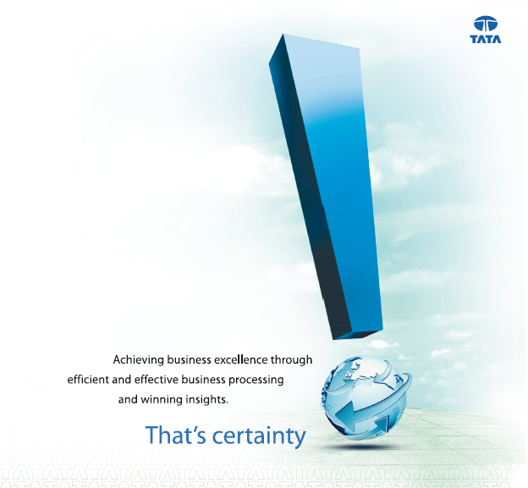
THANK YOU

